Slide 1
Sign Language To Text
Oren Raz and Lam Kai Yi Karen

Slide 2
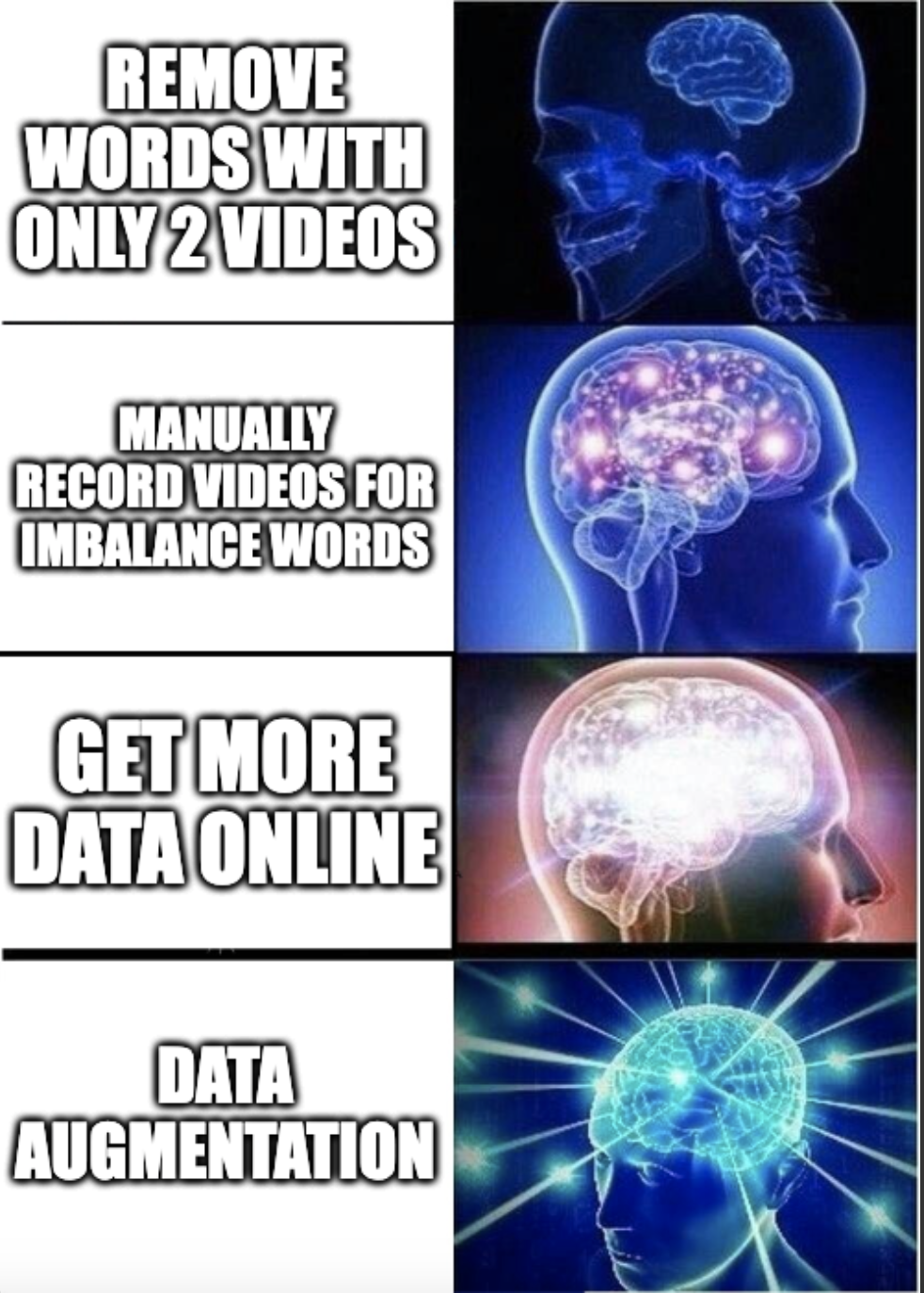
Recall from last week
 | COMPLETE DATASET | AFTER REMOVAL OF MISSING DATA
# of Unique Words | 2000 | 2000
# of Unique Sources | 19 | 9
# of Unique Signers | 119 | 78
# of Instances | 21083 | 11980
Average Instances Per Word | 10.5415 | 5.99
Minimum Instances Per Word | 6 | 2
Maximum Instances Per Word | 40 | 16

Slide 3
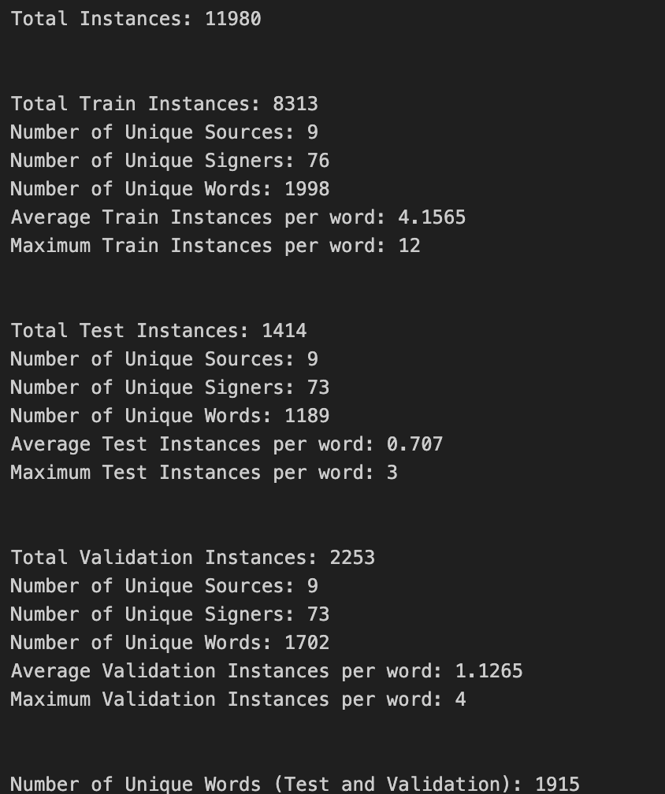
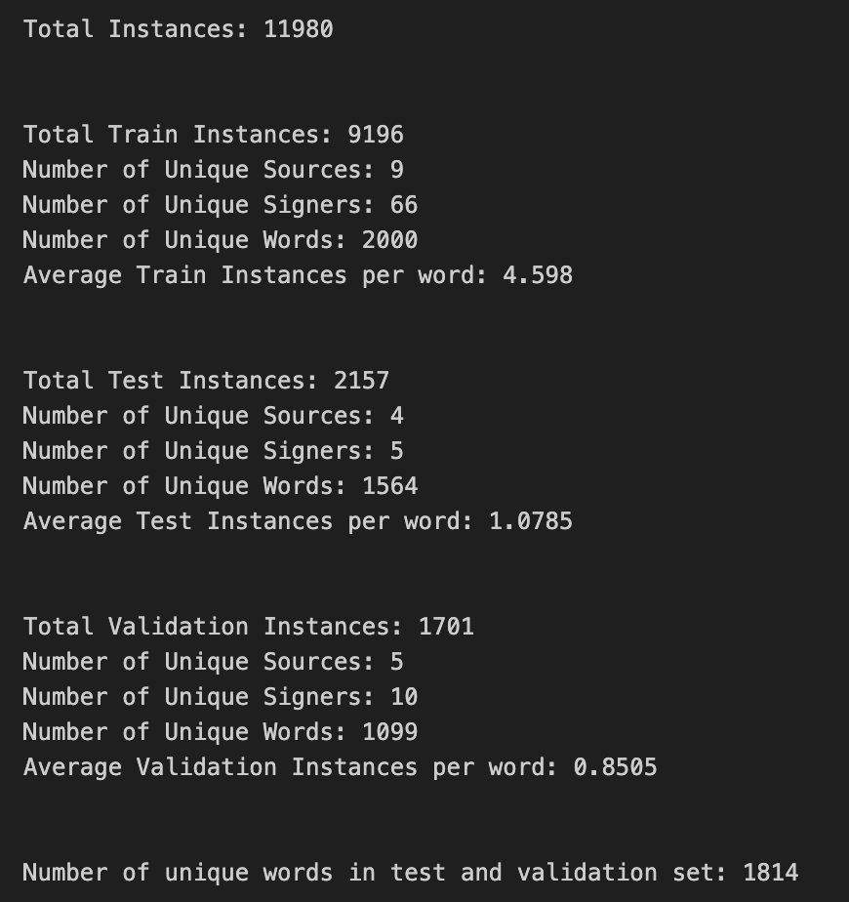
Data Improvements: Train-Test-Validation Split
TRAIN SET
#118, #31, #59, #11, #115, #94, #6, #21, #10, #38, #56, #41, #4, #45, #32, #46, #13, #42, #39, #17, #89, #60, #35, #15, #3, #92, #93, #34, #107, #28, #99, #37, #8, #97, #70, #19, #91, #106, #63, #29, #26, #117, #66, #119, #50, #103, #120, #95, #78, #27, #108, #57, #53, #75, #104, #43, #40, #77, #1, #33, #22, #105, #48, #73, #23
TEST SET
#2, #52, #12, #98, #88
VALIDATION SET
#59, #115, #90, #4, #116, #100, #101, #102, #96, #90, #36

Slide 4

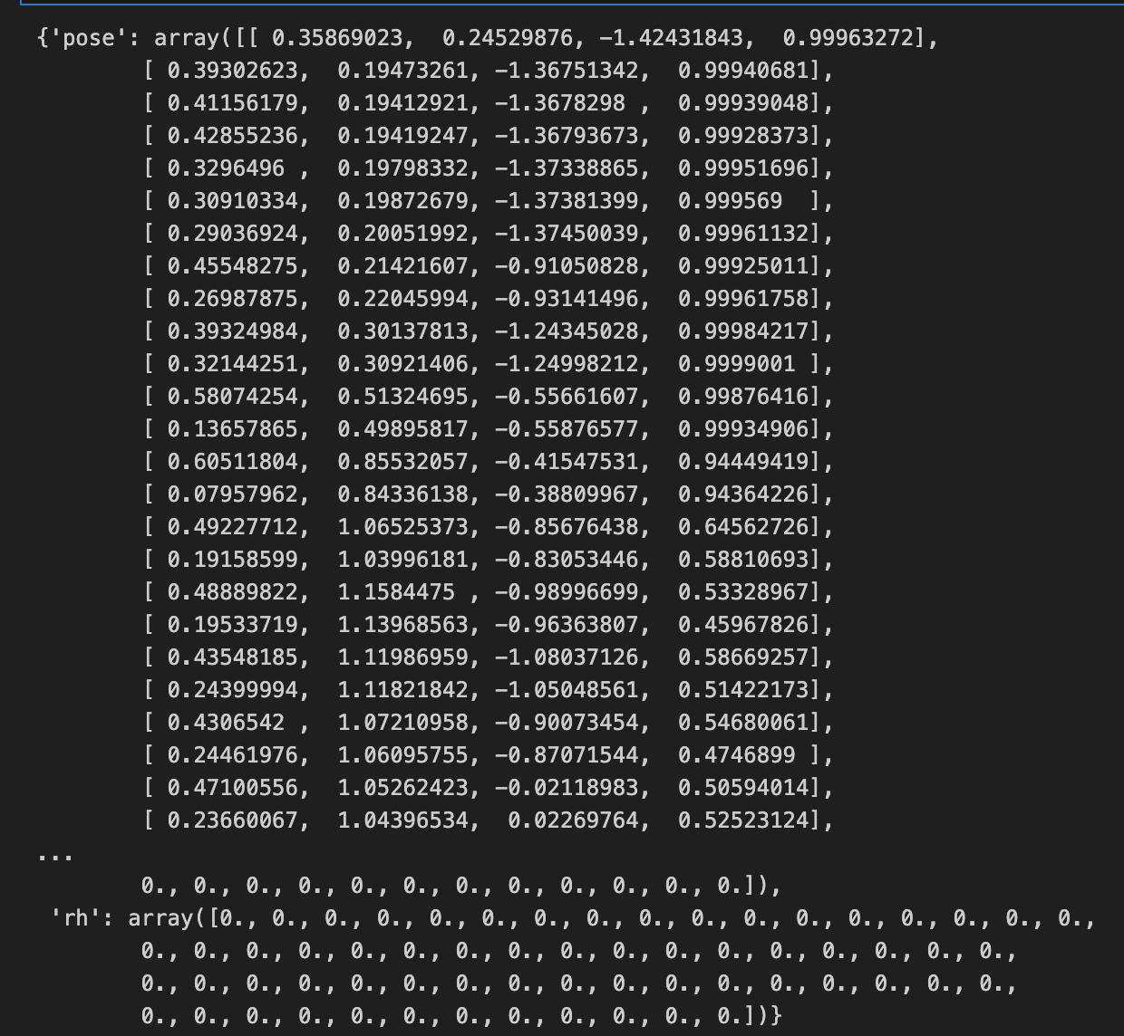
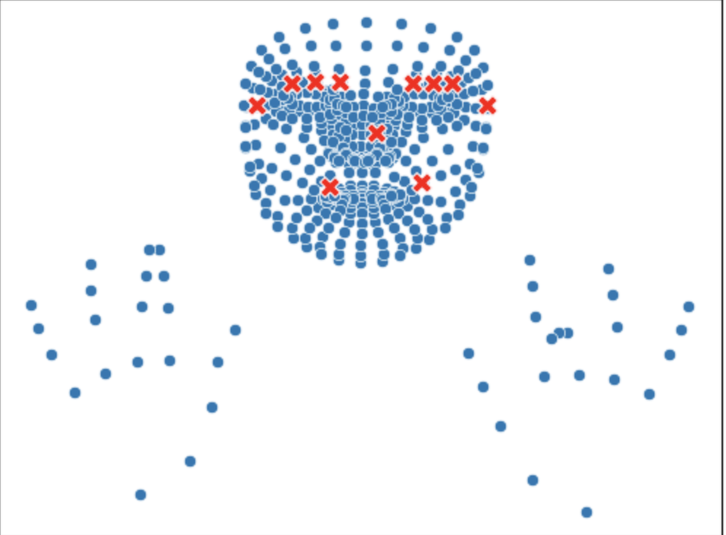
Data Experiments – Feature Engineering:
Extraction of Key Features
EXTRACTING KEY FEATURES
Key Feature Points include joints of fingers and arms, eyes, and mouth
Extraction of Key Feature Points for each frame in 11,980 videos --> 11,980 arrays of Key Feature Points

Slide 5
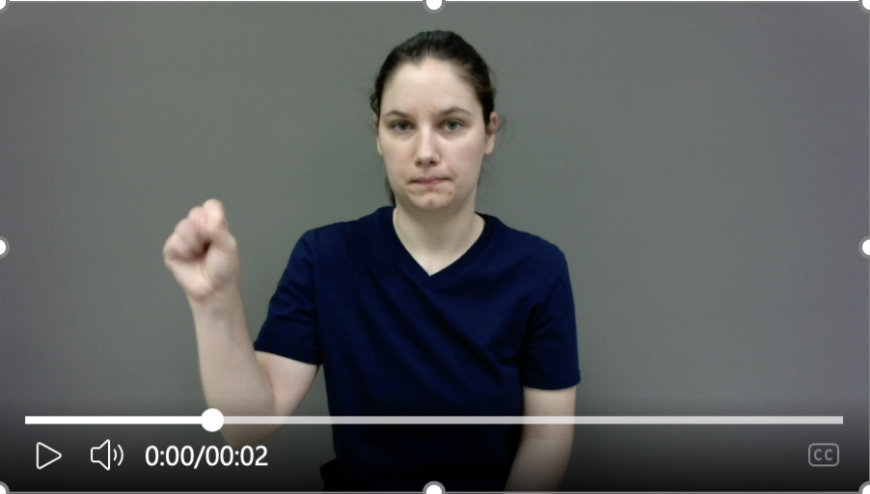
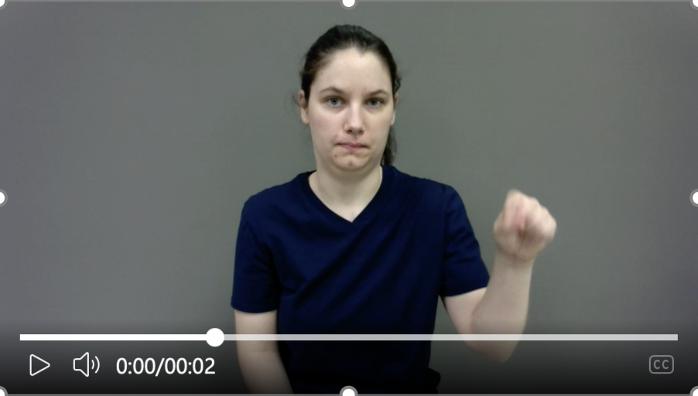
Data Improvements – Feature Engineering:
Lateral Flipping of Key Feature Points
CATERING TO DIFFERENCES BETWEEN LEFT AND RIGHT HANDED SIGNERS
69546.mp4 --> "Yes"
Right Handed
Left Handed
For signs that only require one hand --> USE DOMINANT HAND

Slide 6
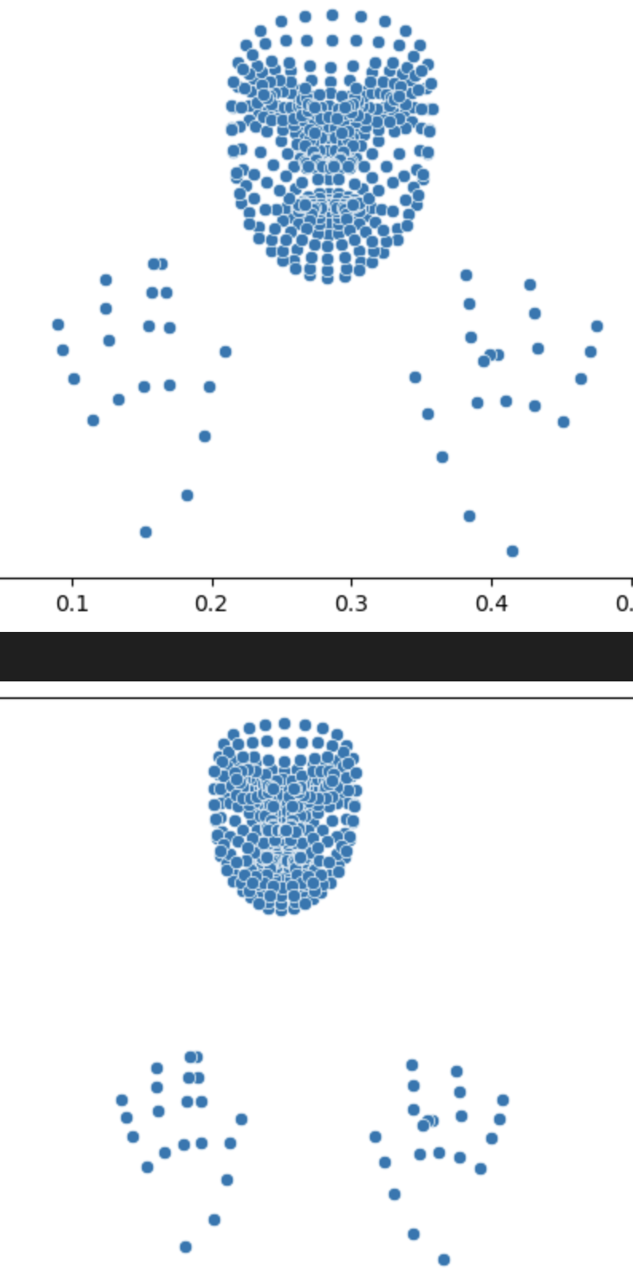


Data Experiments – Feature Engineering:
Translation of Key Feature Points
CAPTURE VARIATIONS IN MOVEMENT IN VIDEO FRAME
Key Feature Points include joints of fingers and arms, eyes, and mouth
Extraction of Key Feature Points for each frame in 11,980 videos --> 11,980 arrays of Key Feature Points

Slide 7
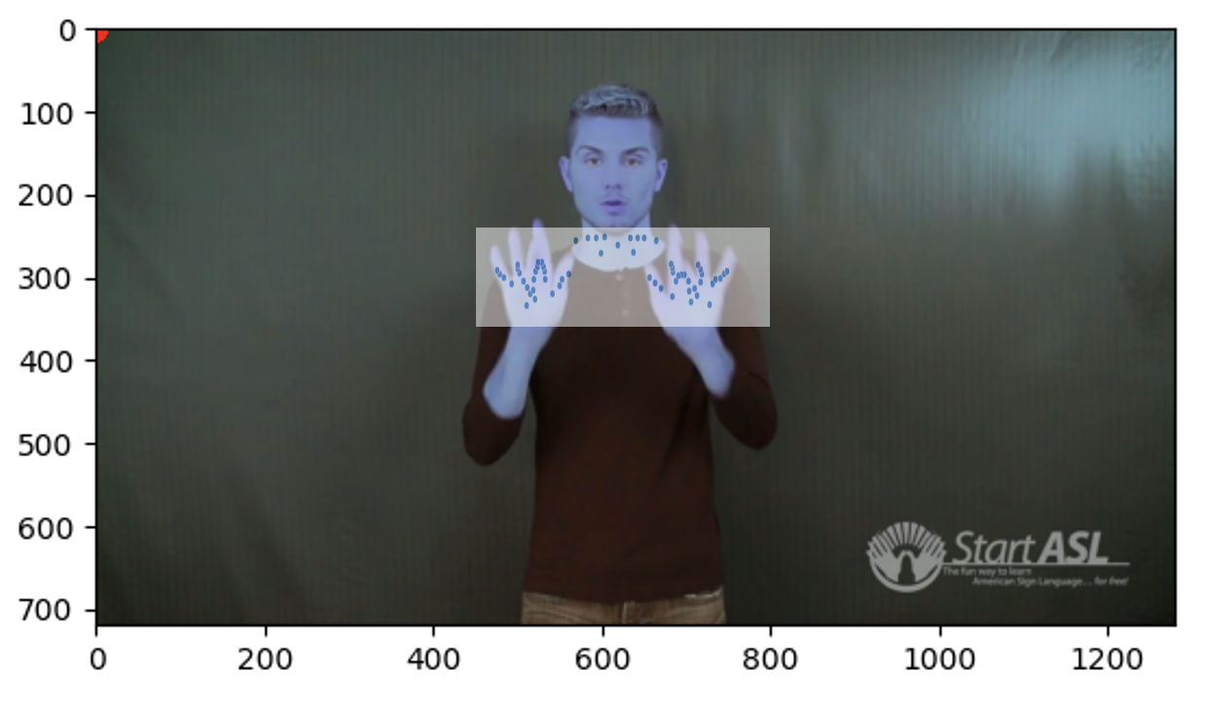
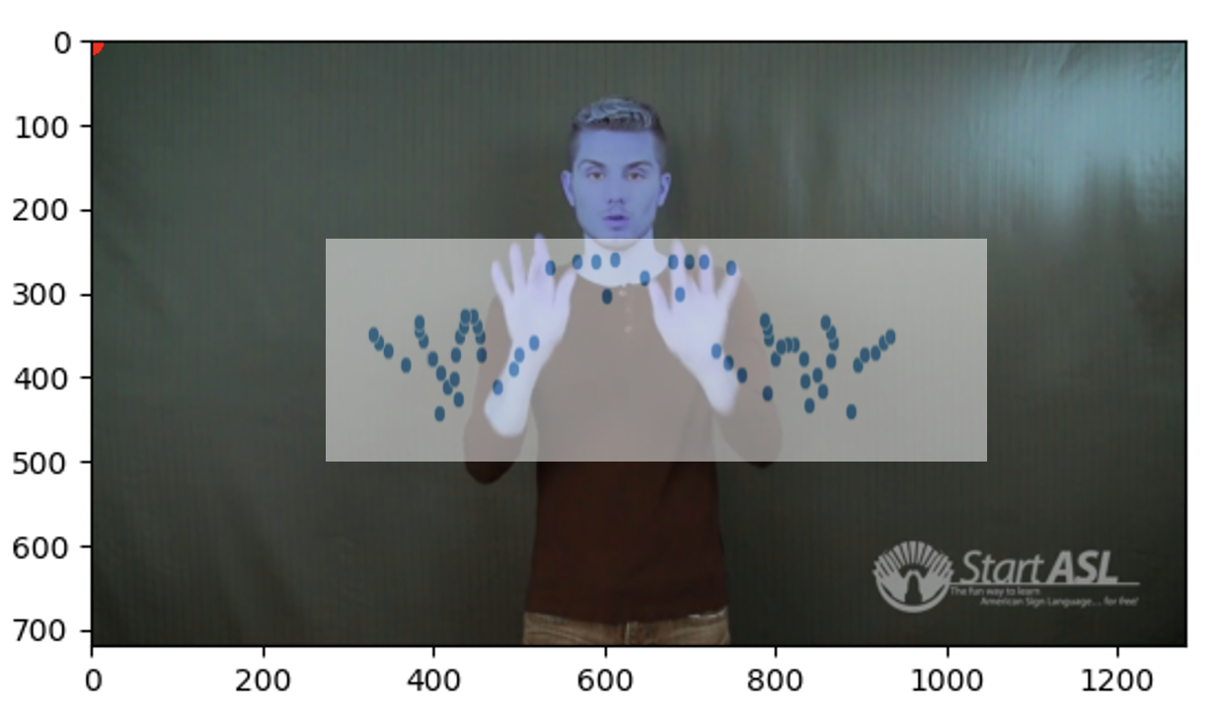
Data Experiments – Feature Engineering:
Zooming In of Key Feature Points
CAPTURE MOVEMENT OF DIFFERENT SIZE IN VIDEO FRAME

Slide 8
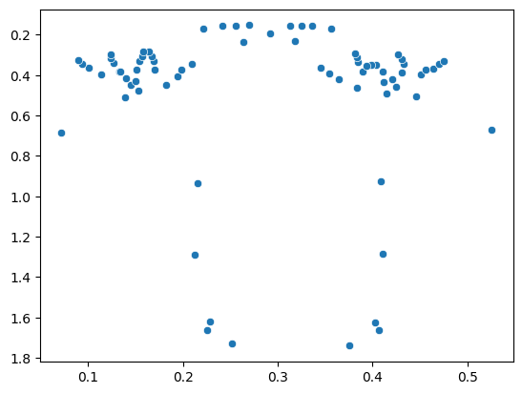
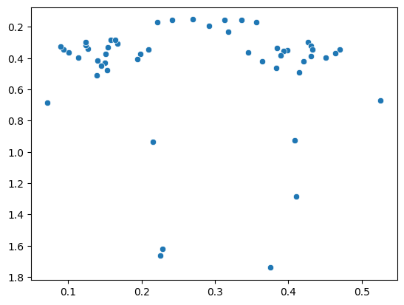
Model Testing – Anticipating Problem of Overfitting
RANDOM REMOVAL OF KEY FEATURE POINTS
DIMENSIONALITY REDUCTION
Data
543 landmarks (33 pose landmarks, 468 face landmarks, and 21 hand landmarks per hand) --> NUMBERED
Possible Feature Selection Algorithms to Test
Principal Component Analysis
Temporal Dimension Reduction
Frame averaging, frame differencing, or keyframe extraction
Tensor Decomposition
Represent a video as a tensor (e.g., frames × height × width) and apply tensor decomposition techniques to extract spatial and temporal patterns.
Random removal of
30% of data points

Slide 9
Reflections
Completed Stage
Data Collection
Data Split – Train, Test, Validation
Data Exploration
Feature Engineering
Challenges / Considerations
Size of Data Set --> Processing of videos for pre-processing takes a lot of time
Need to capture temporal movements between frames of signers
Next Stage
Create Baseline Model
Test on:
Extracted Key Feature Points
Extracted Key Feature Points + Feature Engineering

